Slide 1
CS 205
Artificial Intelligence

Slide 2
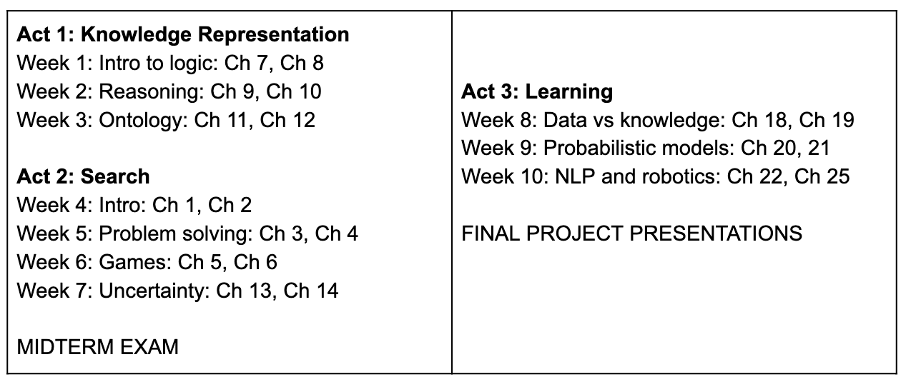
Where are we now?

Slide 3
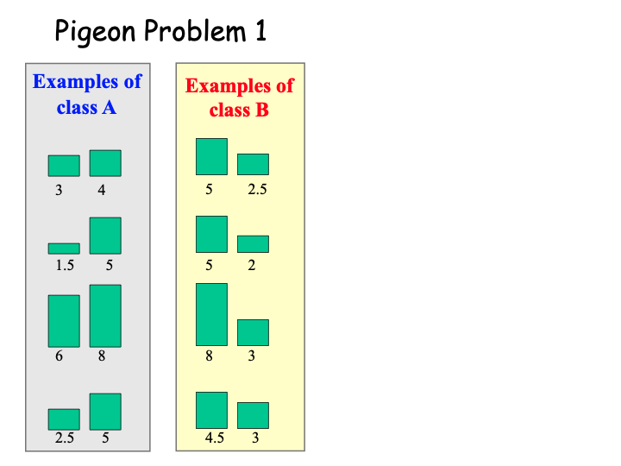
Let's play a game...

Slide 4
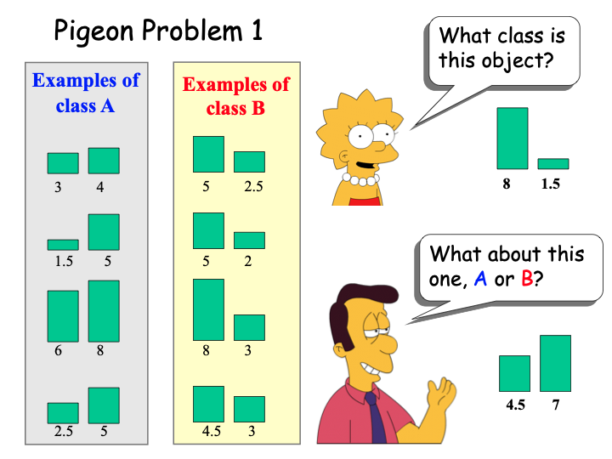
Let's play a game...

Slide 5
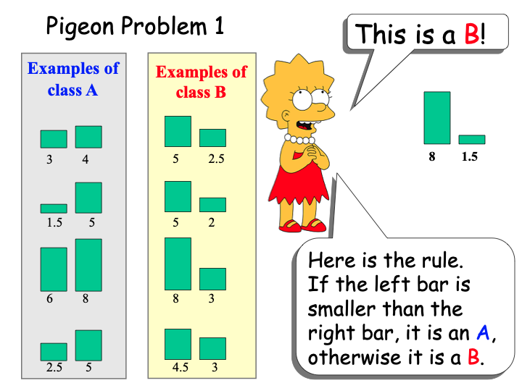
Let's play a game...

Slide 6
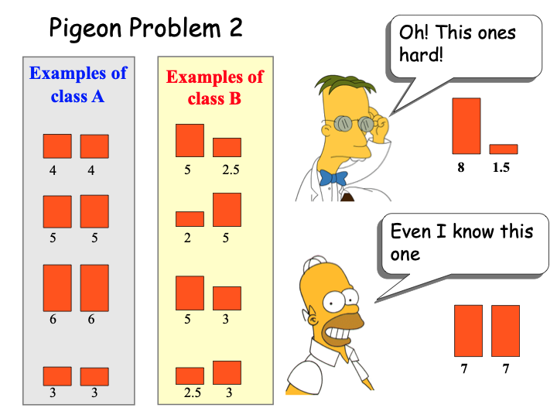
Let's play a game...

Slide 7
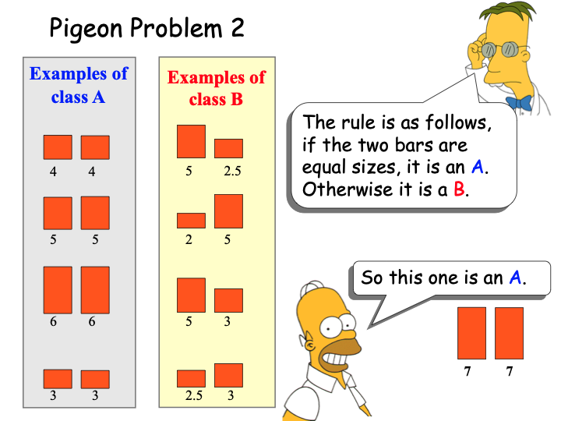
Let's play a game...

Slide 8
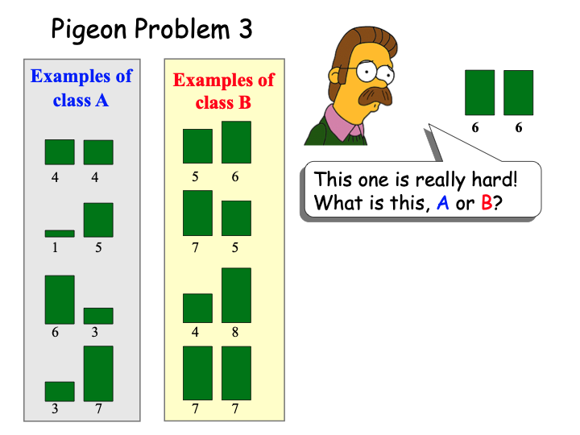
Let's play a game...

Slide 9
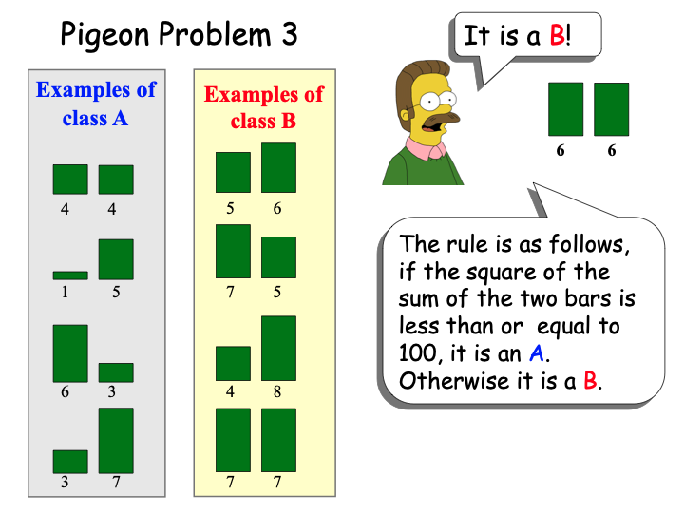
Let's play a game...
wait a minute... really?

Slide 10
Activity #3
Posted on Slack #homework
"Choose your own adventure" style exploratory project in Machine Learning.
Scope it well. You only have 2 weeks!
Share your discovery by tutoring us, i.e., create a step-by-step tutorial.
Get more presentation practice by telling us about your journey. We don't want a walkthrough of your tutorial (we can do that on our own), we want to know WHY we should. Sell it to us! Persuade us! Excite us! The best way to do that is to convey your excitement about certain aspects, i.e., what makes you proud of your work.

Slide 11
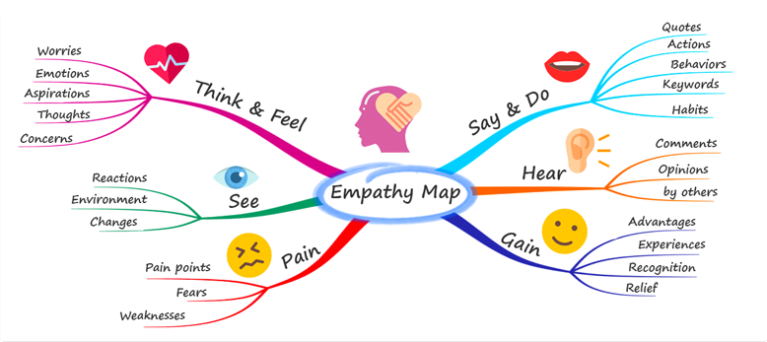

Mind-mapping
Tasks:
Brainstorm: What comprises machine learning? Jot down all the ideas and concepts that come to mind.
Mind-map: compose those thoughts together into a mind-map.
Save and Share when we regroup.

Slide 12
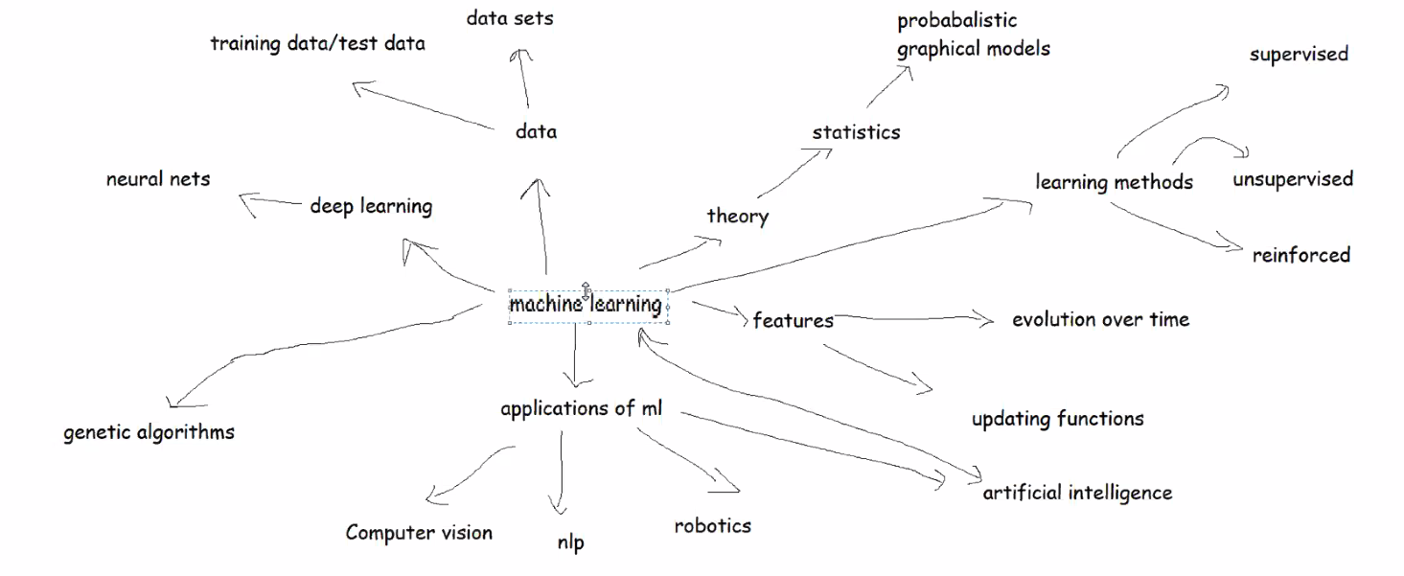
Mind-mapping Results

Slide 13
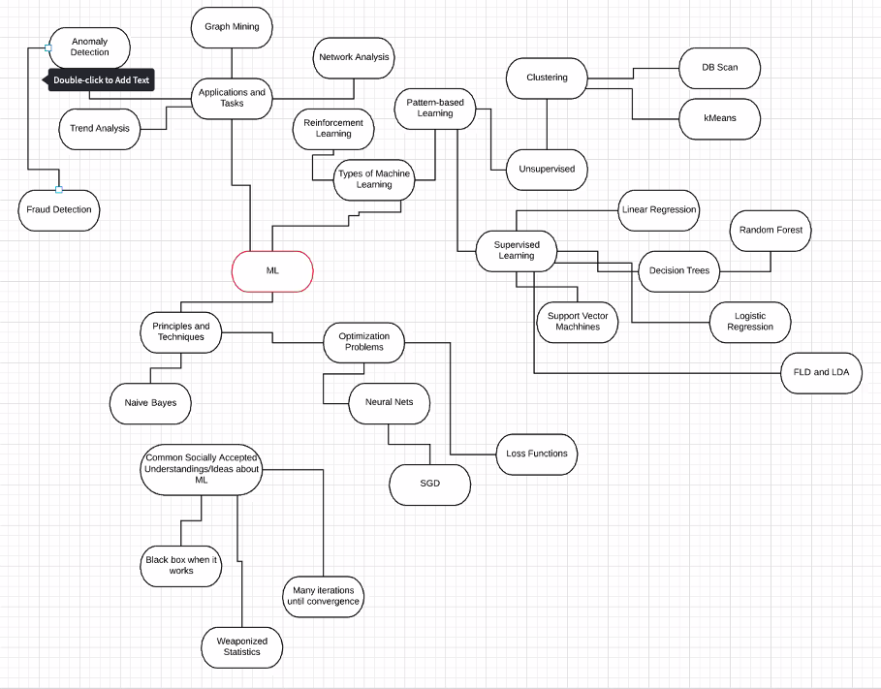
Mind-mapping Results

Slide 14
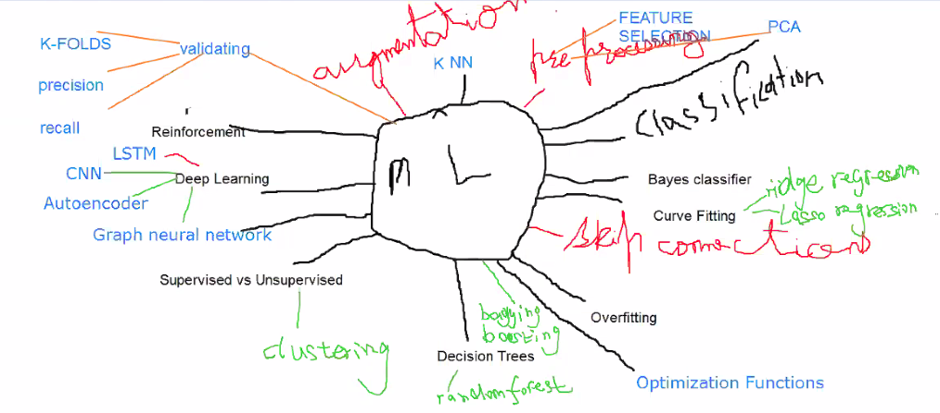
Mind-mapping Results

Slide 15
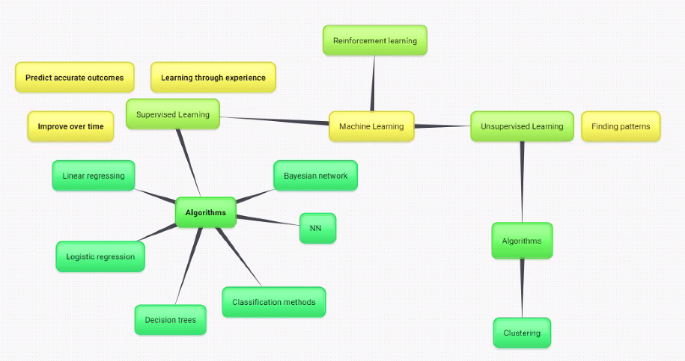
Mind-mapping Results

Slide 16
Next time...
Study the Machine Learning slides from Prof. Eamonn. This is an area in which he really excels and his slides are great!
Start working on your Activity 3.

